Slide 1
Big Data Processing
Training a Higgs Boson Classifier With Distributed Computing
Sidharth Ambady

Slide 2



About me
Recent graduate from UBC Materials Engineering
Excited to explore the world of Data Science & Engineering
https://github.com/sambady3
https://www.linkedin.com/in/sidharth-ambady/
sambady3@gmail.com

Slide 3
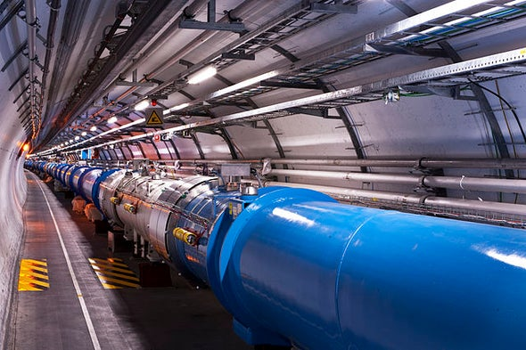

Project Motivation
Motivation: Learn and utilise the Apache Spark engine with Databricks to create ML pipelines
Observe the capabilities of Spark to process 'big data' with increasing complexity
Observe the scalability of Spark by scaling up as well as scaling out compute nodes to see how well Spark scales with distributed computing
Dataset: Higgs Data Set
Identifying Higgs Bosons from background noise
11 Million Instances
28 Features (21 measured features, 7 high-level features derived by physicists)
Size : ~3.5 GB
Polynomial Expansion
Capture non-linear feature interactions
increase feature complexity
“The power of the DN to automatically find nonlinear features reveals something about the nature of the classification problem in this case: it suggests that there may be little gain from further attempts to manually construct high-level features.”[1]
Notes:
- Adjust quotation , link purpose of quote to polynomial expansion

Slide 4
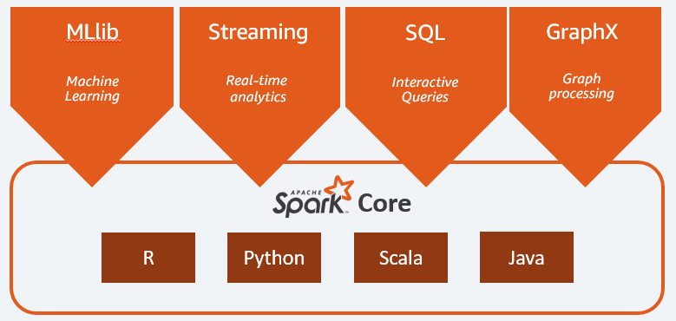

Apache Spark and Databricks
Spark
Spark RDDs
2. In-memory processing
3. Lazy Evaluation
Databricks
End-to-end platform built on-top of Spark
2. Cloud Computing Integration
Notes:
High level bullet points, link to databricks for further reading

Slide 5
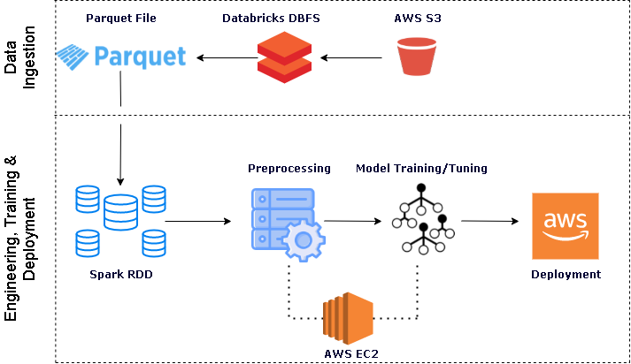
Data Pipeline
Notes:
Swimlanes

Slide 6
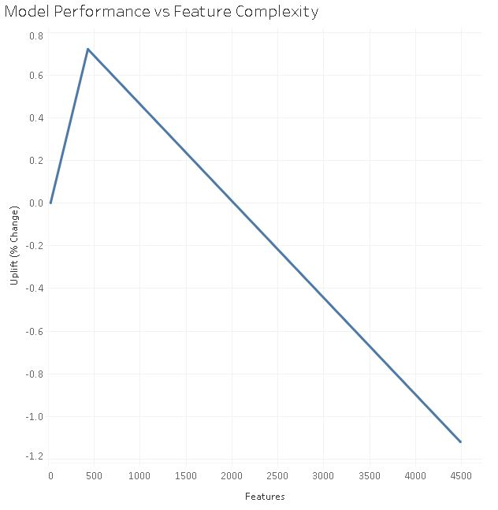
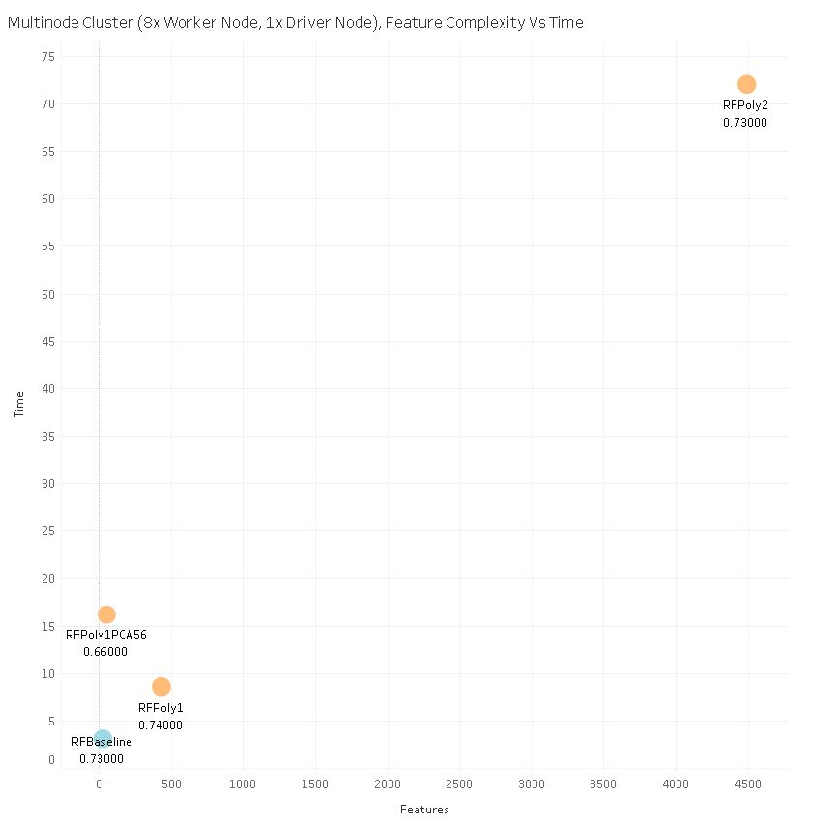
Model Performance
&
Feature Expansion
Takeaways:
High energy particle physics domain generates massive amounts of data
Polynomial feature expansion successfully captures non-linear feature interactions
Furthers requirement for big data tools
Spark successfully trains large models on highly dimensional data
Pretrained model provided
Save researcher compute resources and time
Allows for easy hyperparameter tuning to obtain best performance
Notes:
Adjust Plots, 1 chart per slide

Slide 7
Scaling Compute
Multi Node Cluster
Single Node
Baseline Node
-Scale out
-Obtain runtime metrics
-Explore cost implications
Construct & iterate pipelines
Increase feature complexity
-Obtain model performance & identify best pipelines
-Obtain runtime metrics
-Scale up
-Increase feature complexity further
-Obtain model performance & runtime metrics
15.3 GB, 2 Cores
244 GB, 32 Cores
1x Driver, 8x Workers
30.5 GB , 4 Cores Each
Notes:
Consistent colour scheme, key takeaways, merge 6 and 7

Slide 8

Results : Distributed Computing & Cost Implications
Takeaways:
Spark pipelines efficiently scale
- Both vertically and horizontally
2. Scaling up vs Scaling out
Comparable resources with cheaper components
Auto-scaling allows for cost efficiency when scaling out
3. Additional Benefits
Fault tolerant systems
Infrastructure complexities abstracted out
Local storage autoscaling on each machine
15.3 GB, 2 Cores
244 GB, 32 Cores
1x Driver, 8x Workers
30.5 GB , 4 Cores Each
8 DBU / hour
3.2 $ / hour
3-9 DBU / hour
0.4 $ / hour / node

Slide 9
Closing Thoughts

Slide 10
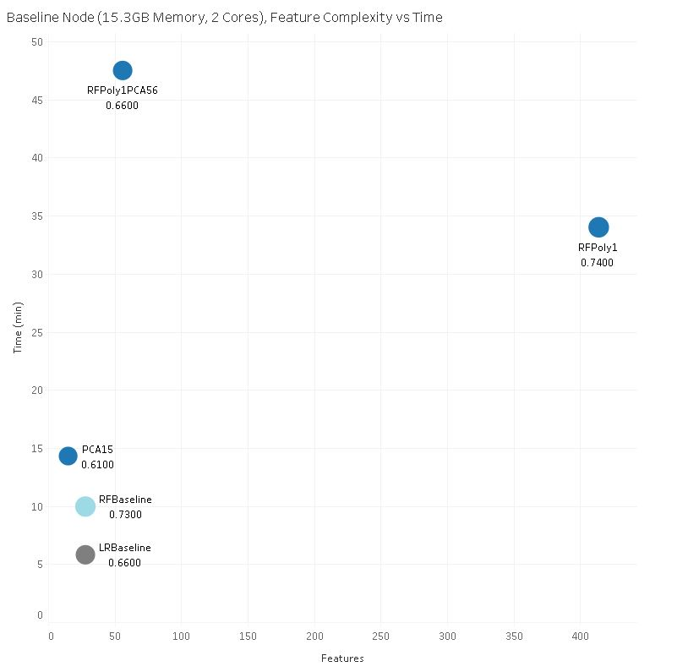
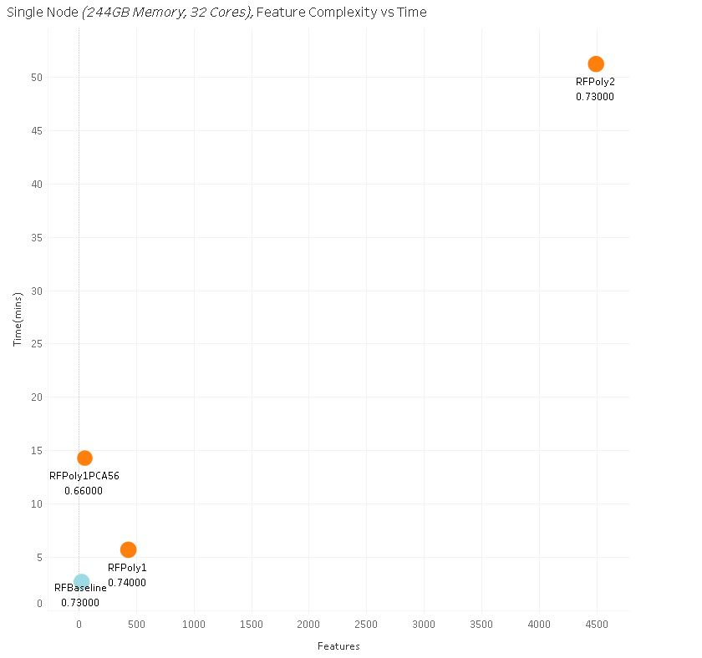

Appendix :
[1] Baldi, P., P. Sadowski, and D. Whiteson. “Searching for Exotic Particles in High-energy Physics with Deep Learning.” Nature Communications 5 (July 2, 2014).
https://databricks.com/spark/about
https://databricks.com/spark/comparing-databricks-to-apache-spark
https://aws.amazon.com/ec2/instance-types/
Notes:
Links to software in appendix

